Slide 1
Move-in and Orientation Week 2021

Slide 2
Populations & Class Size
First-Year Students
Transfer Students
Parent + Families
Oxford Graduates
Remote Students
Returning Students

Slide 3
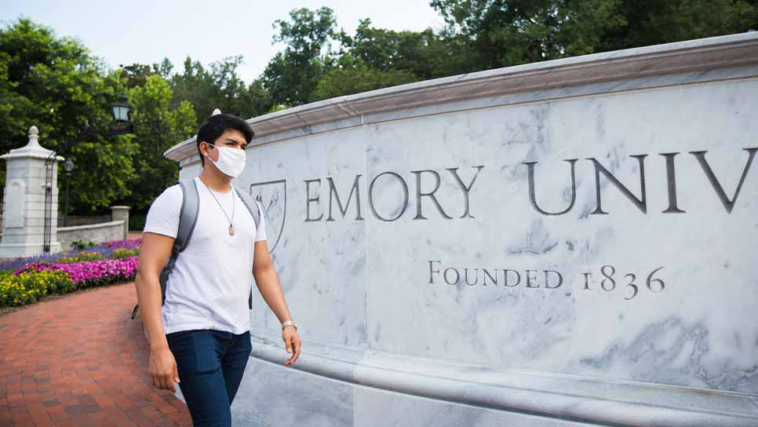
COVID Vaccinations
Residential Student Vaccination Rates
Student Vaccinations and Testing
Restrictions
Move-in

Slide 4
Housing & Dining
Approximately 4,600 beds on campus
Expect 100% occupancy
First year students concentrated on main campus
Primarily 3rd and 4th year students on Clairmont Campus
Campus Dining
Cox Hall, Depot, Starbucks and School of Medicine locations now open
All other dining locations will reopen with in-unit dining and full density on Sunday, August 22
Faculty/staff meal plans expected to resume for spring semester

Slide 5
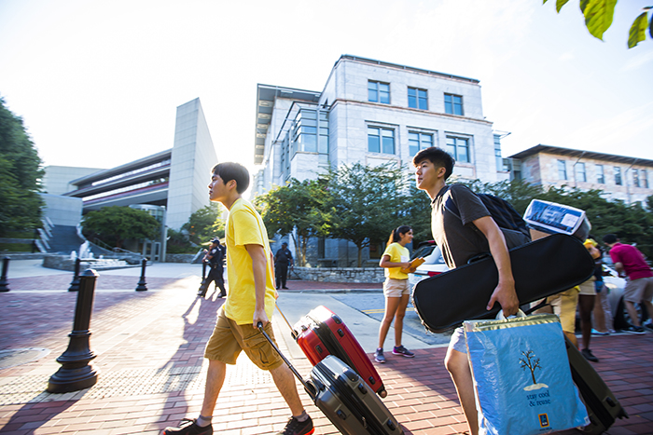
Move-in Dates
August 14
Student Leaders
August 17
First-Year Pre-Orientation Programs
International Students
Student Athletes (fall sports)
August 21
First-Year Students
August 22-August 24
Returning Students

Slide 6
Mail Services and Logistical Support
Package Pick Up locations (PODS): 8/16 - 8/22
Complex
Eagle Hall Parking Deck
Woodruff Hall
Clairmont Campus
Moving Assistance for Incoming Students
Professional Movers to assist students and their families on:
8/17 – Early Arrivals
8/21 – 1st year
8/22 – 2nd year
Courtesy Shuttles to assist families
8/21
8/22

Slide 7
What will students experience?
Move-in, welcome experience
Formal Orientation programming
Free time
Time with family on Sunday morning
Additional Orientation programming Sunday-Tuesday
The days are full (Orientation staff is making clear what is optional and what is mandatory)

Slide 8
Orientation Week August 21-24, 2021

Slide 9
Big Changes
No EXPO
Digital Class Photo
Coca-Cola Toast
Separate for FY and Parents
Transfer
Parent Programming
Schedule
Moving to The Hub
At-a-Glance on NSP Website

Slide 10
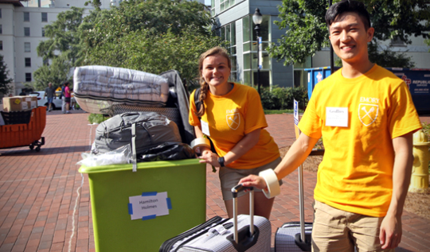
Saturday, August 21: Move-in (7am-2pm)
Explore Campus
Tabling in ESC
Carlos Museum
Emory Library
Barnes & Noble College Bookstore
Campus Tours
Services & Support
EmoryCard
Student Technology Support
Financial Aid and Student Accounts
Vaccination Clinic
College Council Shopping Shuttles
Residence Hall Meet and Greets
Students of Color Welcome (2:30-3:30)
First Generation Student and Family Reception (3:30-4:30)

Slide 11
Saturday, August 21
First-Year Student Programming
Orientation Welcome + Coca-Cola Toast
Dinner + Orientation Leader Small Group
Residence Hall Floor Meetings
Emory After Dark
Evening Emails Begin: Title IX and Respect
Parent + Family Programming
Parent + Family Reception
Parent + Family Welcome

Slide 12
Sunday, August 22
Breakfast + Morning Mindfulness
Time for you and your family
Welcome Center
Spiritual and Religious Events
Emory Photo Challenge
Songfest Practice
Meet Your Deans
Rec the Night

Slide 13
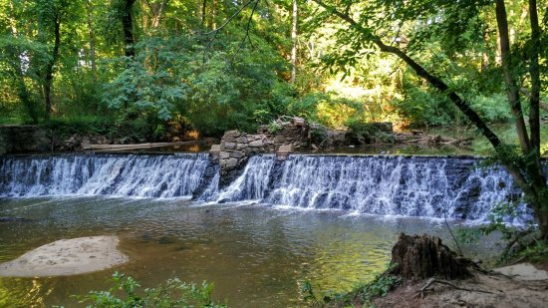
Morning Mindfulness Menu
Yoga Class on First-Year Quad
Guided Meditation
Journaling
Nature Walk
Reading

Slide 14
Photo Challenge
Small groups of 5 students
75 minutes
Clues
Donald Glover, Amy Schumer, and John Mulaney are just a few of the comedians who have made Emory laugh with free comedy shows at Glenn Memorial. Give us your best LOL in front of Glenn and take a picture for 1 point.
Emory College of Arts and Sciences boasts more than 50 departments and programs, 86 majors, and 63 minors – serving more than 5600 students annually (hey, that’s you)! Find an Orientation Leader and record a video of your team asking them what their major is for 2 points.

Slide 15
Monday, August 23
Breakfast + Morning Mindfulness
First-Year Faculty Connections (Zoom)
Explore Academic Tracks
Academic Advising Drop-in Hours (Hybrid)
Academic Department Info Sessions (Hybrid)
Eagle Edge: New Student-Athlete Orientation
Services for English Language Learners Info Session
LGBT Welcome
Orientation Leader Small Group
Songfest Practice

Slide 16
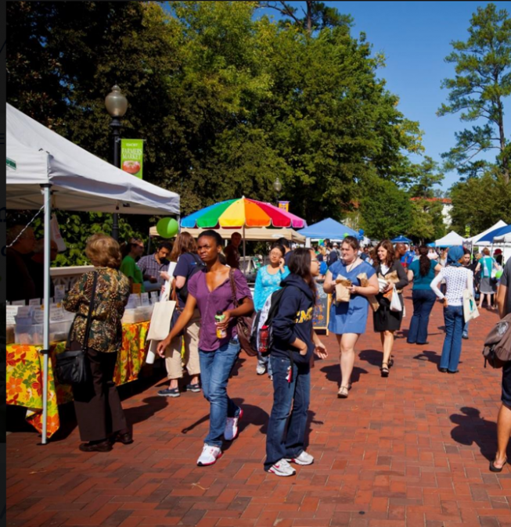
Tuesday, August 24
Breakfast + Morning Mindfulness
Orientation Leader Small Group: Bystander Training
Developing a Growth Mindset: Adapting to College Using Mental Hygiene
Federal Work Study Fair
Emory Farmers’ Market + Sustainability Showcase
Open Houses: Career Center, EPASS, and Pre-Health
Back to School at the Emory Libraries
Find Your Classes
Spiritual and Religious Life Fair
Student Studio at Carlos Museum
The First Day of Class and Beyond with Pamela Scully
Emory Convocation
Final Orientation Leader Small Group with Dessert

Slide 17
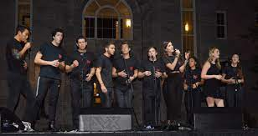
Wednesday, August 25-Saturday, August 28
Wednesday 8/25 → Movie Night on McDonough Field
Thursday 8/26 → SongFest in the WoodPEC
Friday 8/27 → Choose-Your-Own-Adventure Night
Saturday 8/28 → Best in Show

Slide 18
Friday, August 27
Choose-Your-Own-Adventure Night
7:30-10:30 p.m.
Roller Skating 4th Floor WoodPEC
Casino Night ESC Multipurpose Rooms
Field Day McDonough Field
Game Show Event WH 208 (Show will run 2-3 times)
Trivia Cox Hall (Trivia will run twice)
Smore’s n’ More Asbury Circle
Movie Night First Year Quad
Silent Disco Campus Life Pavilion
Shabbat Dinner Hillel

Slide 19
Transfer Student Orientation
August 22-24
ECAS and GBS Students
Transfer-specific programming and all-class programming
Full schedule will be online by end of the week

Slide 20
Volunteers
Thank you!
Stay tuned for more information from volunteer coordinators for more information.
Some roles are very event-specific.
Welcome Table, Campus Direction Ambassadors, and Golf Cart Drivers may get asked more broad FAQs.

Slide 21
Thank you!
Q&A

